Slide 1
Mental Health and
Employment
Bradley Caldwell, Ariana Davis, and Stacey Marotta
May 2023
Notes:
Bradley

Slide 2




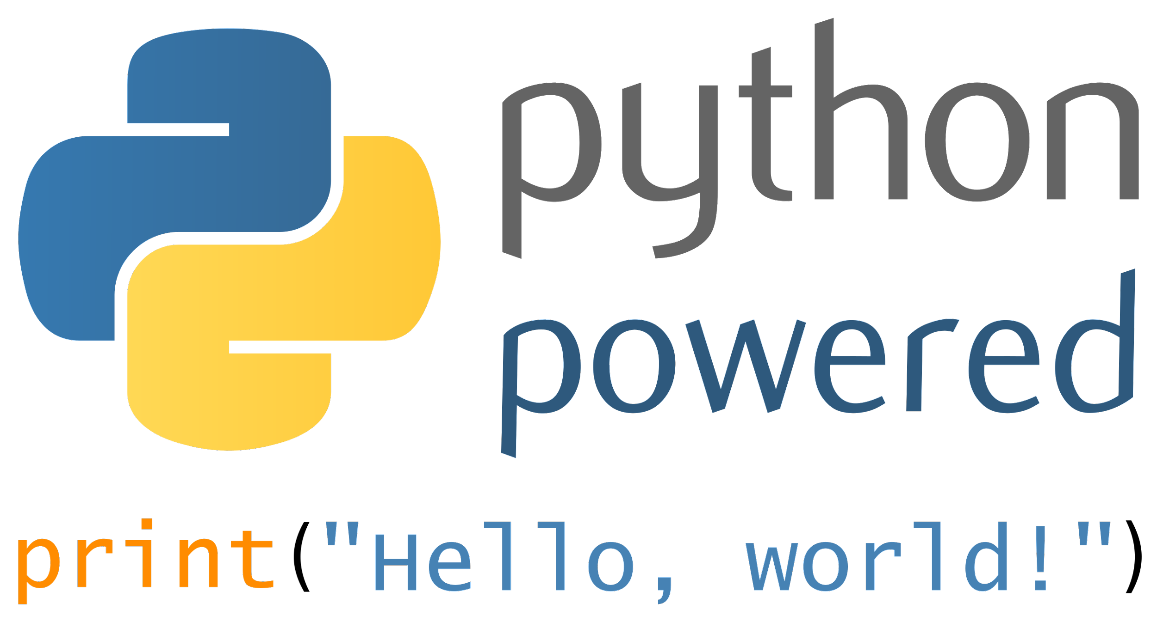

List of Technologies
QuickDB
pgAdmin4 with postgresSQL
Jupyter Notebooks with Python
Visual Studio Code
Tableau
Github
Notes:
Stacey

Slide 3



Communication Plan
Slack Group
Zoom Meetings during class, and additional meetings outside of class.
Notes:
Stacey

Slide 4

Part 1 - Project Intro + Data Exploration
Notes:
Ariana

Slide 5

Project Statement
The purpose of this analysis is to use Supervised Machine Learning to understand whether or not employers are providing healthcare benefits that includes mental healthcare in the workplace.
Our project would like to examine any relationships between mental health and employment. The dataset selected was survey data that asked participants to talk about their experiences with healthcare and mental health in the workplace.
Notes:
For our project, our topic was mental health and employment. We were interested in seeing how mental health is viewed in the workplace. We wanted to use Supervised Machine Learning model to see whether or not employers provide mental healthcares to employees in their benefits plan.

Slide 6

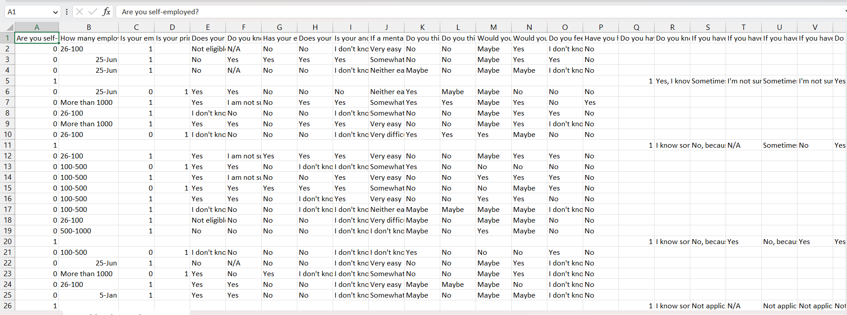
Dataset Selection
Notes:
We began searching for a dataset on Kaggle and through there, found the Open Sourcing Mental Illness(OSMI) website dedicated to getting people to talk about mental health and the resources provided to both tech. and open source communities. The dataset we ended up selecting was survey data that asked participants to talk about their experiences with healthcare and mental health in their place of work. Our group felt that this would be would be a decent representation of relationships of mental health and employment and it met the requirements of having at least 1000 rows of data; ours had 1400.

Slide 7

Questions
Does your employer provide healthcare that includes mental health care?
Does working remotely have a positive or negative impact on one’s employment?
Do you find it possible to be productive even with mental health restraints?
Do you find your employer is supportive of you and your mental health needs?
Does having a mental health disorder have negative consequences in the workforce?
Do companies support employees’ mental health when working from home?
Do all self-employed people work from home?
Do companies foster an environment to speak openly about mental health disorders?
Notes:
While choosing our question that we wanted to ask, we took a deeper dive into our dataset to see what questions were asked and which ones would be the most straightforward and best for a supervised machine learning model to predict. The question we landed on is highlighted. The ones below are other questions that we came up with, but didn’t make the cut. However, we kept them just in case we would be able to answer them while exploring the data, etc. and it would be cool to add in our dashboard or analysis later on.

Slide 8
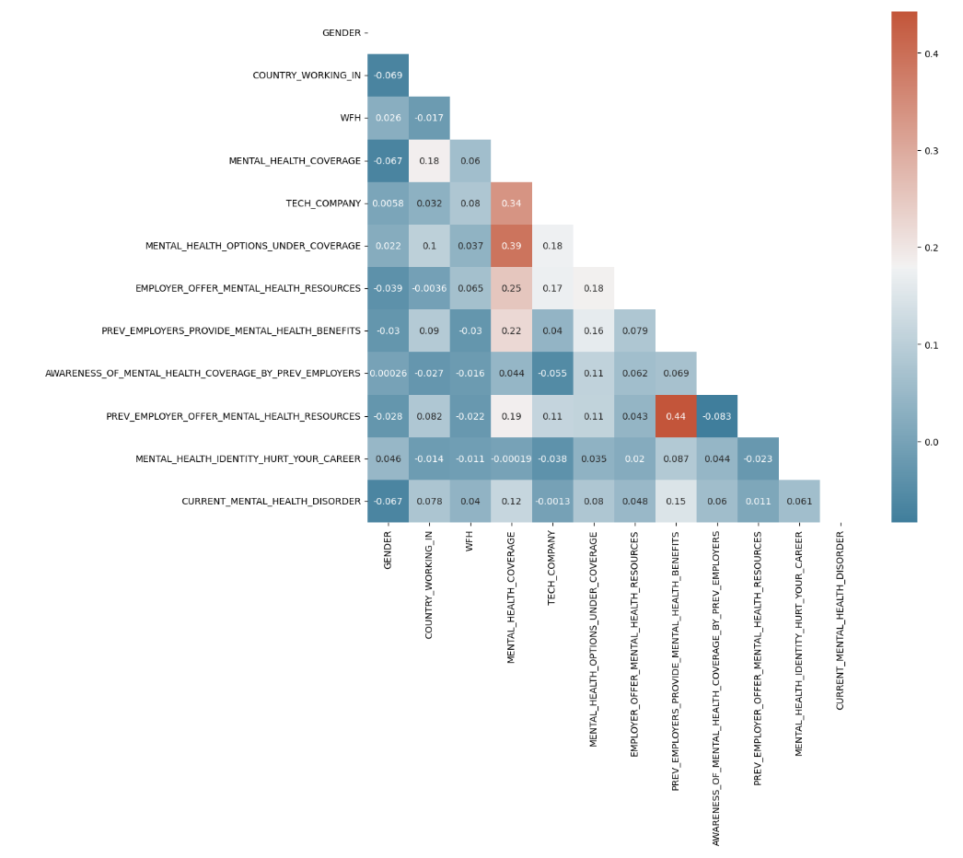
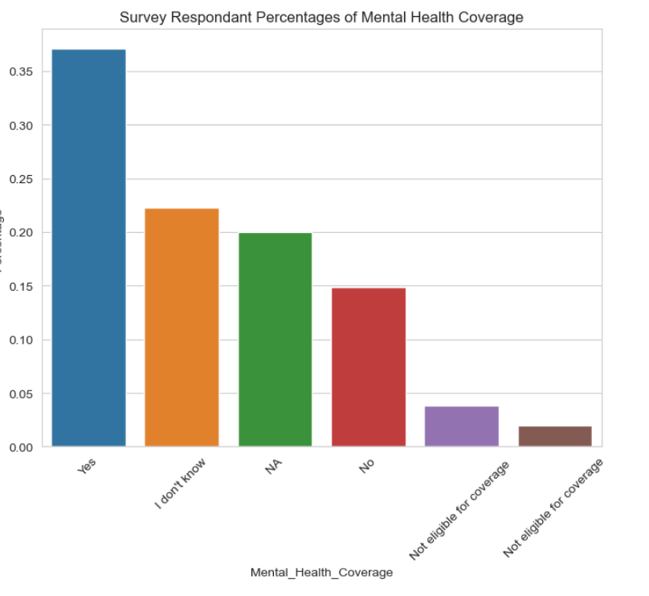
Data Exploration
Notes:
For Data Exploration, we made a few graphs like a bar chart that shows the percentages of mental health coverage by survey respondents. The data is a little bit skewed, but as you can see there are more yes responses than no’s, for mental health coverage. We know that understanding how the features interact with each other is crucial when deciding which features to use in a model because if you have a high number of correlated features, it could cause the model to less effective and accurate. So we decided to use a correlation matrix to find different relationships between the variables in our dataset and determine whether or not they were similar enough to skew the output. In order to display those different relationships, we used a correlation heatmap.

Slide 9
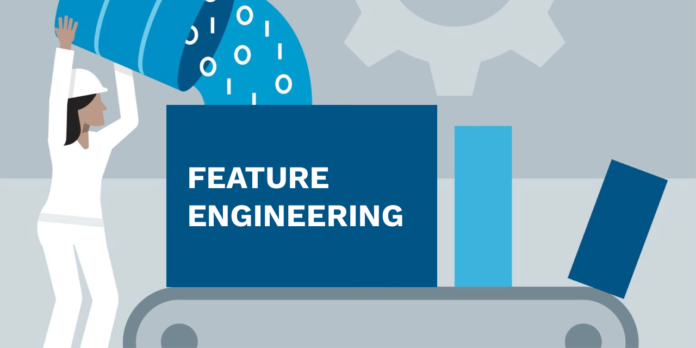
Feature Engineering
When choosing features we had columns with:
Categorical Features
Multiple missing values
Notes:
There were a number of things we had to do in order to transform the given data into a form that was easier to interpret. First, we started off by renaming the columns so they could be more concise and easier to read while coding. When choosing features we had columns with:
Categorical Features; since machine learning algorithms typically work with numerical data, we decided to use ordinal encoding to convert our textual data to numerical data..
Multiple missing values; we had a column with over 1,000 null values. We dropped that column and used fillna() to replace all of our other null values with NA.
Our target was a categorical value as well, so we converted it to an integer to avoid being encoded.

Slide 10

Feature Selection
Target
Interest
Future Analyses & Recommendations
Notes:
Our target was ‘Mental Health Coverage” and whether or not a company offers it as a benefit. So, when choosing our targets we wanted to make sure that they were variables that could help predict that in some way. We also chose features on interest; if two variables could be associated with one another, or have a casual relationship based on a negative or positive correlation. For example, mental health coverage in tech, mental health coverage while working from home? Comparing whether or not companies offer mental health coverage with Age and current mental health disorders could possibly show recommendations to companies to offer mental health coverage to their employees or not. These are all things we were thinking of while selecting our features.

Slide 11
Features
Features
‘TECH_COMPANY’ | 'MENTAL_HEALTH_OPTIONS_UNDER_COVERAGE' | 'EMPLOYER_OFFER_MENTAL_HEALTH_RESOURCES' | 'MEDICAL_COVERAGE_INCLUDING_MENTAL_HEALTH_TREATMENT' | 'PREV_EMPLOYERS_PROVIDE_MENTAL_HEALTH_BENEFITS'
'AWARENESS_OF_MENTAL_HEALTH_COVERAGE_BY_PREV_EMPLOYERS' | 'PREV_EMPLOYER_OFFER_MENTAL_HEALTH_RESOURCES' | ‘MENTAL_HEALTH_IDENTITY_HURT_CAREER’ | ‘CURRENT_MENTAL_HEALTH_DISORDER’ | ‘AGE’
‘GENDER’ | ‘COUNTRY_WORKING_IN’ | ‘WFH’
Notes:
Here is just a list of all of the features we chose.

Slide 12

Target
Target
'MENTAL_HEALTH_COVERAGE?'
Notes:
Here is the target we chose. So, does a company or place of employment have mental health coverage benefits for their employers. We chose this question because we know that models perform better when given the most relevant information about what is being predicted. This question was both relevant and straightforward.

Slide 13
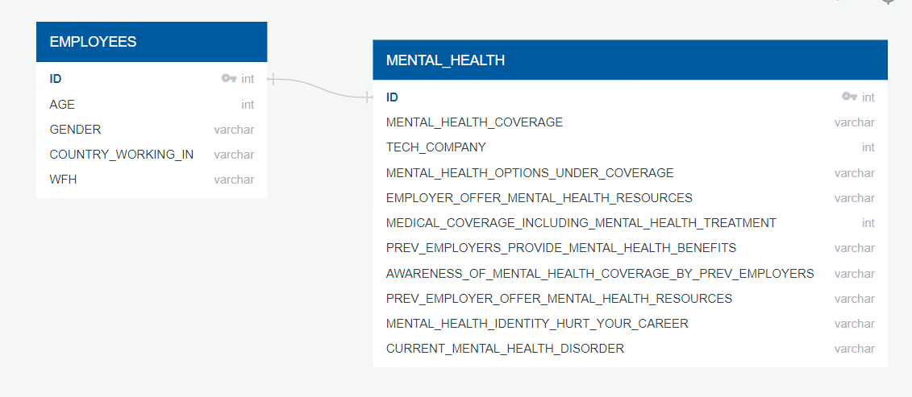
QuickDB ERD
Notes:
Stacey- This ERD was made with QuickDB. We created two tables, one for the general information of the employee respondents, and the second that contained their responses to the questions pertaining to mental health care coverage. We then exported the created schema into PGAdmin4 in order to create our database.

Slide 14
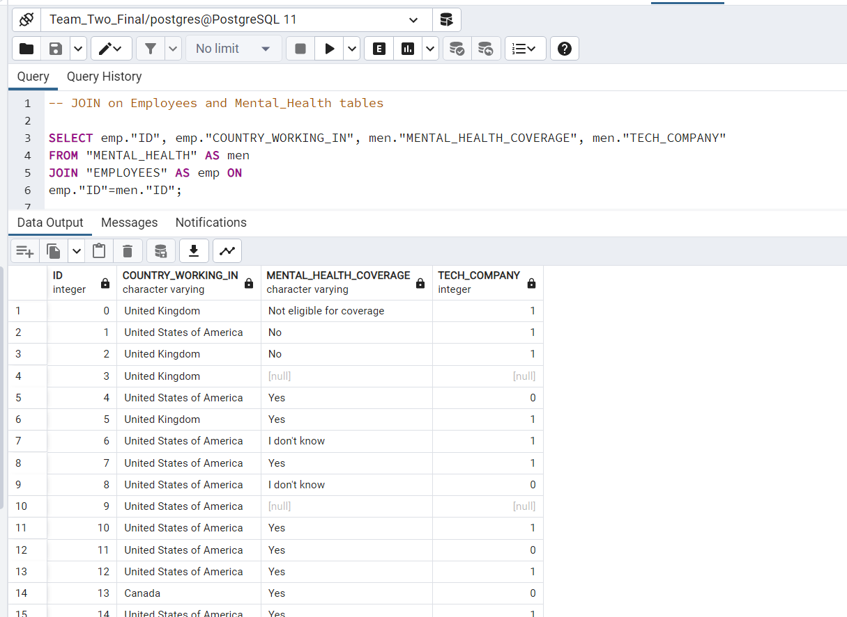
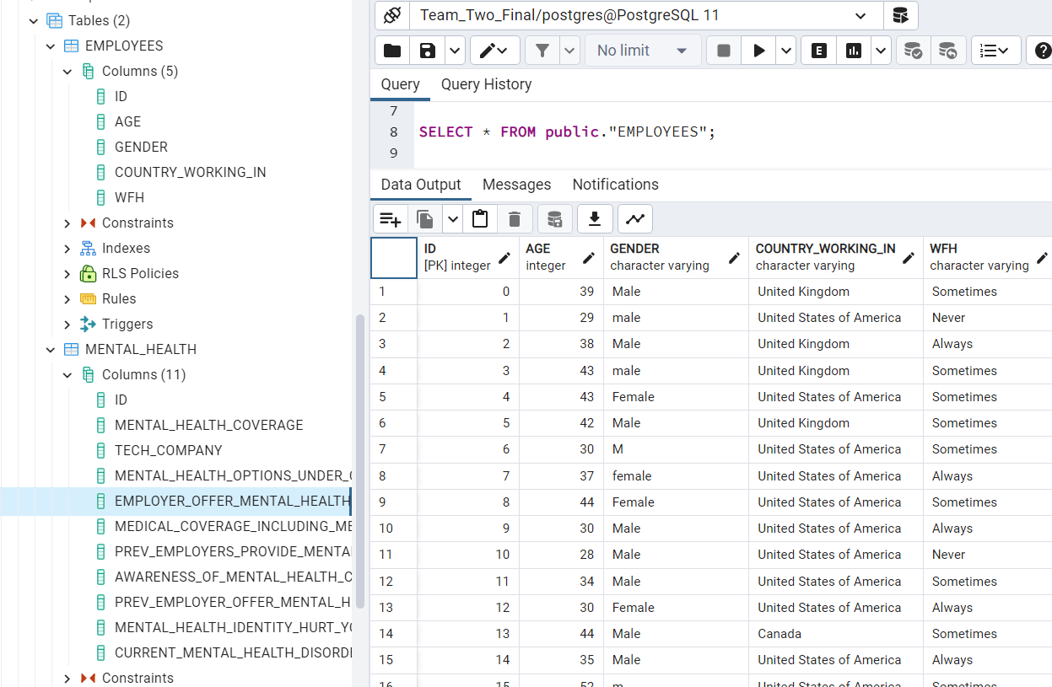
Database
Shows Join
Shows the table columns/simple select query of EMPLOYEES table
Notes:
Stacey- Two screenshots from our PostgreSQL database. Our database was created as a PostgreSQL using PGAdmin4. The two tables from our ERD were created by exporting the schema into PGAdmin. Our data was sliced into two separate csv files containing the proper columns in order to import the data into the appropriate tables. Once both tables of data were imported, we were able to query simple select statements, as well as create a join between the two tables on the ID columns.

Slide 15

Part 2 - Model Preparation + Analysis
Notes:
Bradley

Slide 16

Training and Testing Sets
The training and testing sets were selected using scikit learn’s train_test_split().
Random seed 42 was selected as it’s the answer to the “Great Question” of “Life, the Universe and Everything”.
Notes:
Bradley
Features are the variables used to make a prediction. Target is the predicted outcome.

Slide 17

Machine Learning Model
For our model, we have discrete outcomes. Classification algorithms are know to accurately predict binary outputs, so that is where we started our algorithm search. There are several common classification algorithms such as logistic regression and random forests. The team decided to start with logistic regression, and based on the results it did an okay job at predicting the proper result based on our train and test split. The logical next step was to try out the random forest. The results were better.
Notes:
Bradley
Classification is used to predict discrete outcomes.
Logistic regression predicts binary outcomes, meaning that there are only two possible outcomes
Regression is used to predict continuous variables.
Survey data was an incomplete data source.
This required many assumptions to make and cause unintended bias.
Features were heavily skewed in one direction that may have caused underfitting.

Slide 18
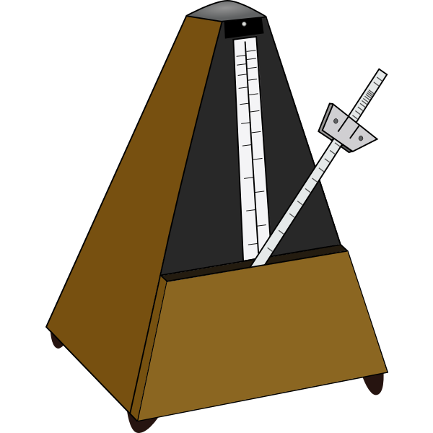
Hyperparameter Tuning
Hyperparameter training was ran on several different algorithms. A machine learning website was referenced in help to finding out on how to optimizing classification algorithms. After hyperparameter training, the GradientBoostingClassifier and XGBClassifier algorithm turned out to have the best accuracy score. SVC,Ridge and KNeighborsClassifier were also trained and tested. Keras tuner was also used for a neural network approach.
Notes:
Bradley
Optimizing of Classification algorithms
Models
Parameters
Random State

Slide 19

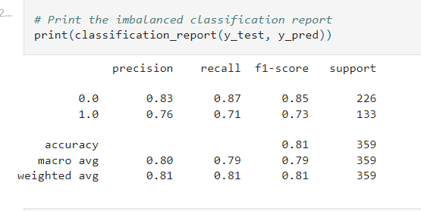
Analysis
How accurate the model is at predicting mental health coverage?
Gradient Boosting Classifier gave the best results
Accuracy Score = .83
Notes:
Bradley - How we answer the question we choose.

Slide 20

Part 3 - Dashboard Preparation + Demo
Notes:
Stacey

Slide 21

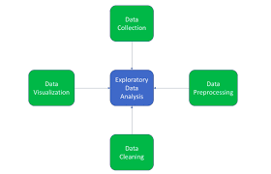
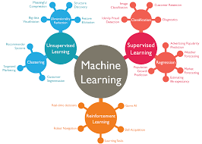

Storyboard
EDA was completed by cleaning & encoding data. A heat map, and plots were displayed to visualize the data.
Our database was created with PostgreSQL. 2 Tables: EMPLOYEES & MENTAL_HEALTH
Will your potential employer offer mental health coverage in your healthcare plan?
Gradient Boosting Classifier algorithm was used to achieve 83% accuracy.
Our question is 83% likely to be answered accurately.
Notes:
Stacey - should I read through this storyboard, even tho all of these processes will be already explained?
This storyboard demonstrates our processes we used to complete our final project. First, we decided on a question that we wanted answered: Will your potential employer offer mental health coverage in your healthcare plan? Next, we created a PostgreSQL database using PGAdmin4 . This data was cleaned, and encoded during the EDA phase of our project. A heatmap and plots were created from the data after EDA was completed. Multiple machine learning algorithms were ran in order to achieve the best accuracy. Of those, the Gradient Boosting Classifier was the best achieving 83% accuracy.
This storyboard gives our basic structure used for this project. We decided on the question we wanted answered, created the database according to the features/target data we selected. We performed EDA to the dataset we chose. The machine learning model was created using the gradient boosting classifier, and we found the model to be 83% accurate as to predicting whether a company will provide health care coverage in their insurance coverage.

Slide 22
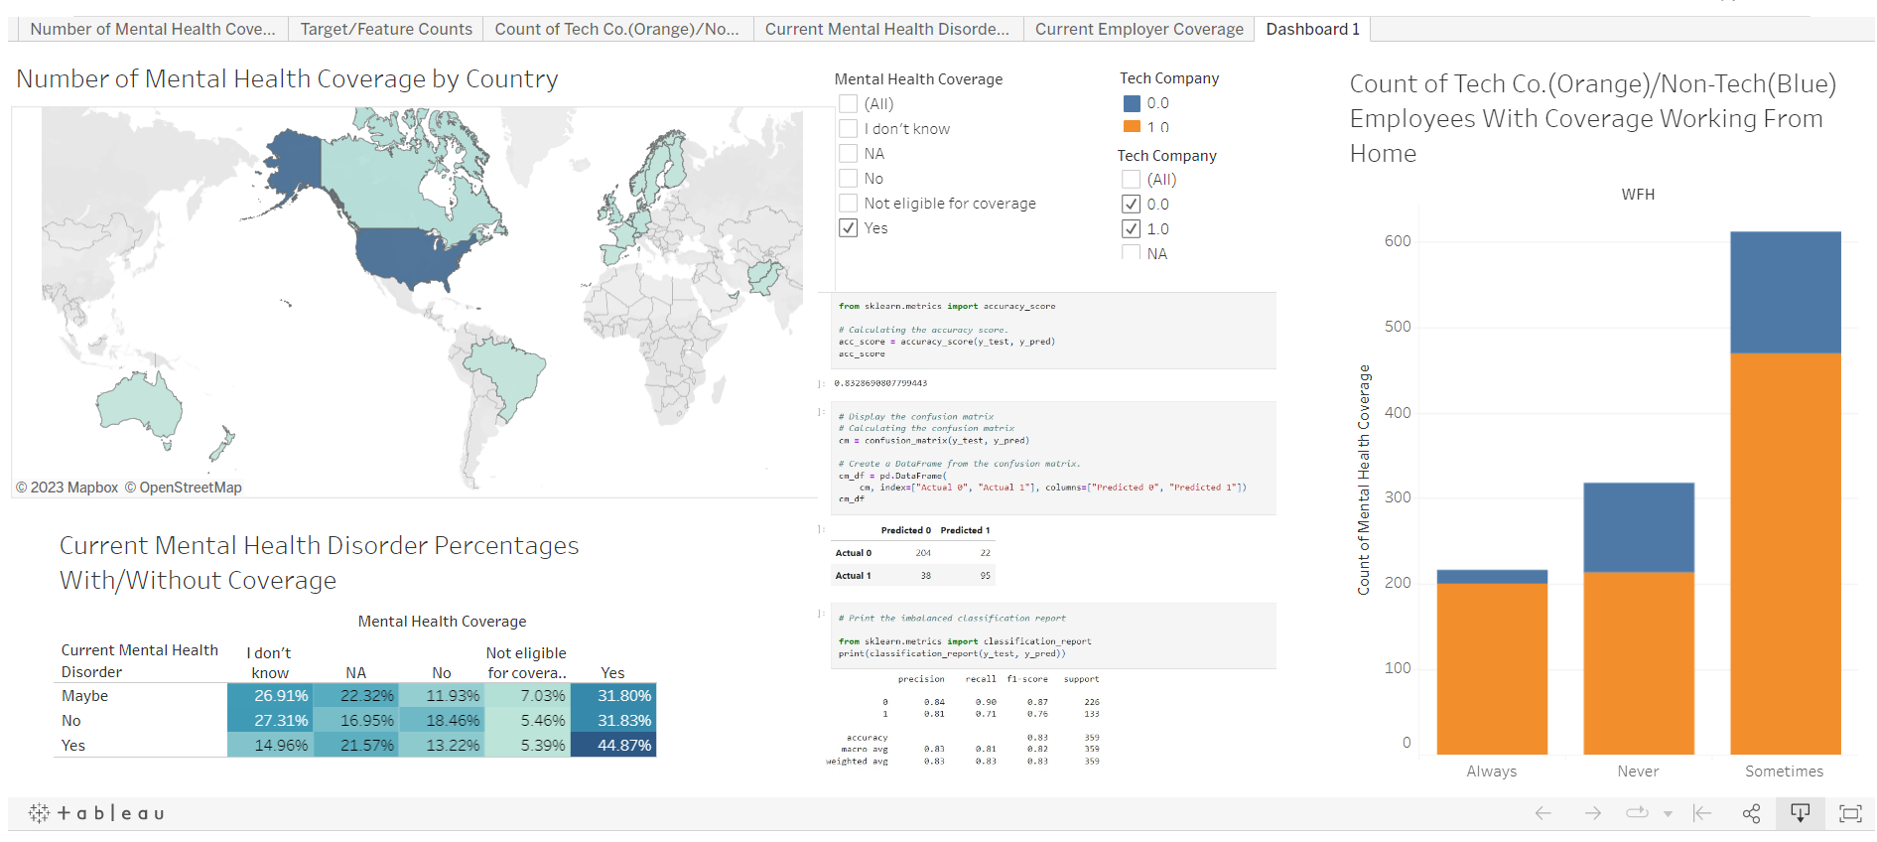
Dashboard Demo
https://public.tableau.com/app/profile/stacey.marotta/viz/Mental_Health_FP/Dashboard1?publish=yes
Notes:
Stacey - A dashboard was created with Tableau Public. Of the five worksheets created, three were used on the Dashboard. The first worksheet (Number of Mental Health Coverage by Country) is a world map showing the counts of mental health coverage by country. This worksheet is interactive because you can adjust the filters to show the different counts in each country for the different coverage responses: Yes, No, NA, I don't know, and Not eligible for coverage. This map is interactive so that the user can select the specific count they are interested in seeing for each country.
The third worksheet is a bar chart that shows if the respondents company is a tech company or not, and whether or not the respondent works from home Always, Never or Sometimes. We were interested in this number because we were curious if there is a relationship between mental health and working from home, and whether or not an employer would offer coverage for those employees working from home that would need mental health coverage.
The last worksheet used on the dashboard shows the percentages from the answers of the respondents as to whether they have a mental health disorder (yes, no, maybe) and if those respondents have mental health care coverage (Yes, No, NA, I don't know, Not eligible for Coverage). This was interesting to see the correlation between someone who has a mental health disorder, and if they do or do not have mental health care coverage to treat the disorder.
Most importantly, we used an image displaying the results of the accuracy score, confusion matrix, and classification report for our machine learning model.

Slide 23
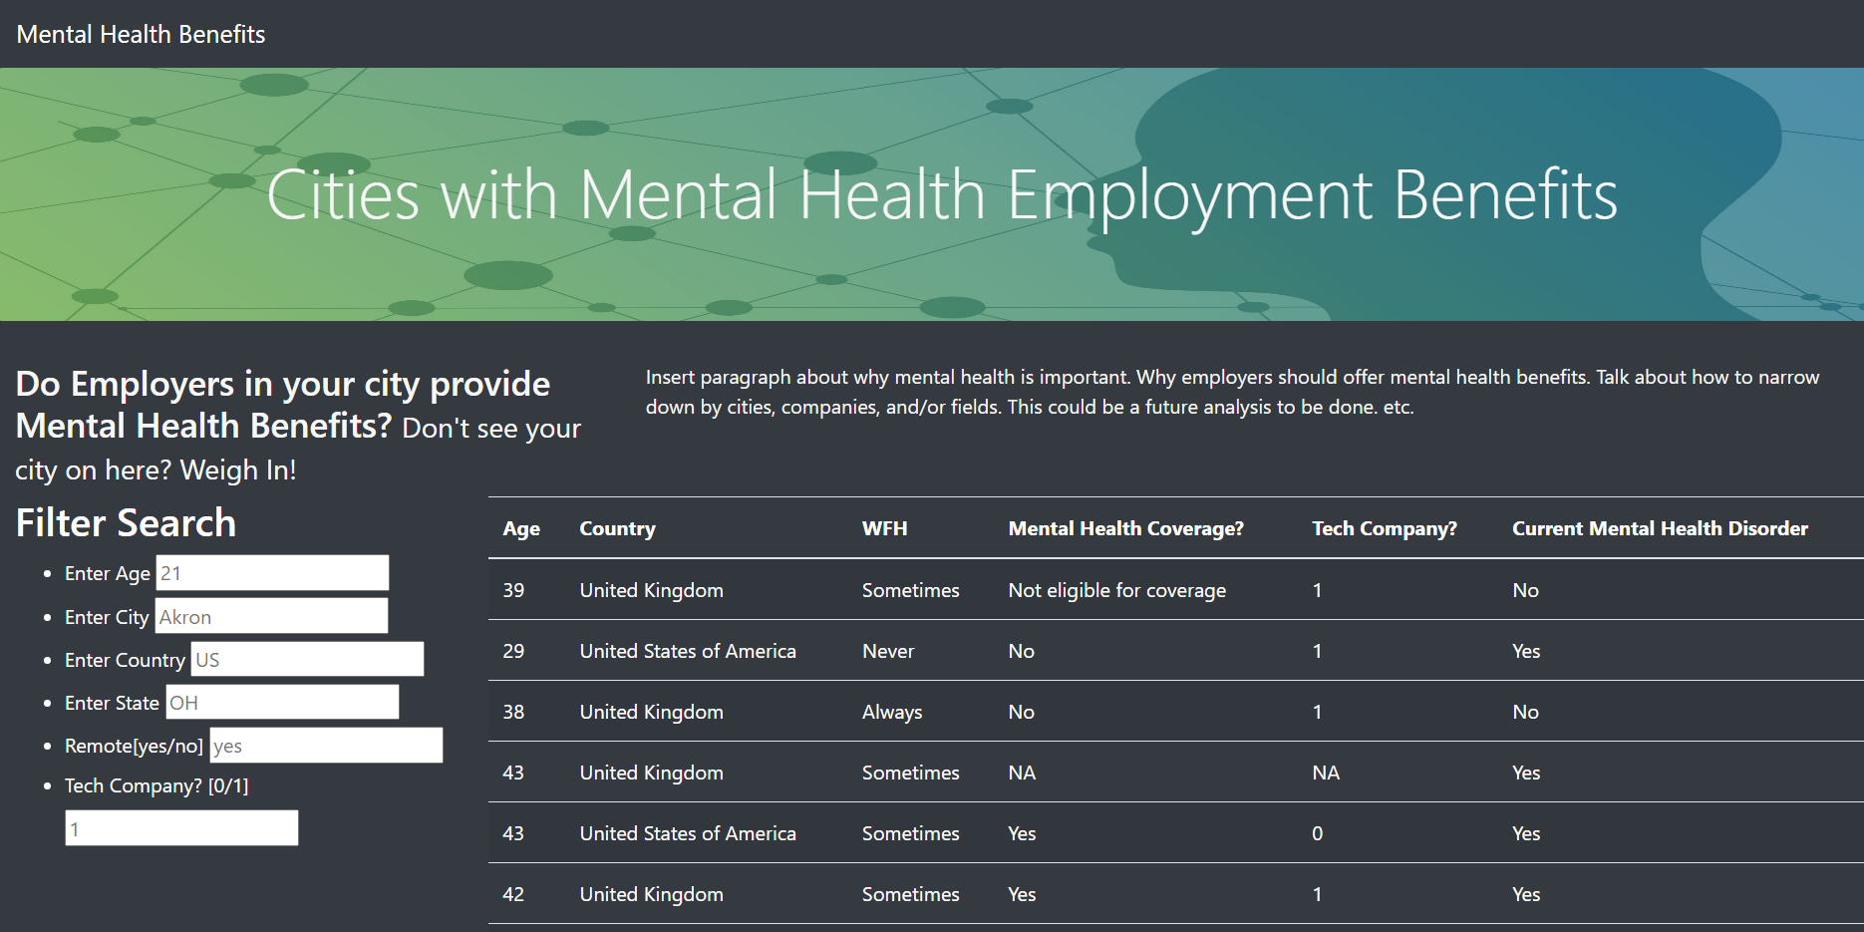

Recommendations for Future Analysis
Re-do analysis using a bigger sample. Increase the accuracy score.
Minimize the number of variables: ex. Turn age into age-groups
Create a website that users could use to filter through state, city, country, etc. for jobs that offer mental health benefits
Notes:
Ariana
Since we got 83% accuracy on whether or not our question is likely to be answered and accurate, one recommendation that we offer is to try this analysis again using a bigger sample. In the beginning, we had concerns that our dataset would be too small, or inefficient due to all of the null values. You could combine other datasets to this one and get more samples and maybe a higher accuracy. Or, you could make the survey responses to be required for respondents in order to have less null values. Another recommendation could be making the data more concise by minimizing variables such as age into age-group. A last recommendation for future analysis could be creating a website that allows users to find places of employment based on whether or not they offer mental health benefits. They could filter based on state, city, age-group, remote work, country and more. This is something that we played around with towards the end. It also just another way you could allow users to explore the data and get the information that they need.

Slide 24

What we do differently?
Not use survey data if possible unless answers are locked to a certain amount of options
Add more data
Classify by features by parametric and non-parametric data
Identify Skew and accommodate
Notes:
Bradley
A larger dataset or different feature selection
Better understanding of our types of data… yes it’s categorical

Slide 25

Q&A
Notes:
Questions

